Slide 1
AVD Anywhere
Mastering Azure Virtual Desktop on Azure Local

Slide 2
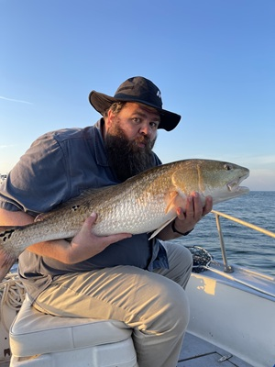
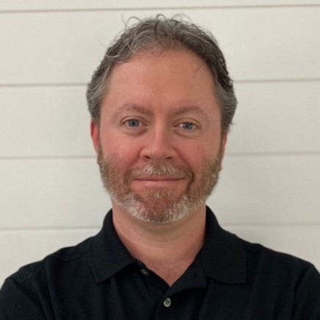


Kristopher Turner
Matthew Wetherell
Minister, Fisherman
IT Infrastructure Manager , USNR
kristopherjturner
in/kristopherjturner
replaceme
in/mtwetherell

Slide 3
The What and Why?
Why do you want to attend this session? Leverage Azure Virtual Desktop (AVD) on Azure Local with confidence despite its quirks. Dive into hybrid AVD architecture, from image builds and VMSS intricacies to FSLogix tuning and GPU placement considerations. Address identity flows, networking constraints, and hybrid lifecycle management. Gain insights into effective monitoring patterns, cost-efficient logging, and strategies to resolve common 'haunted host pool' failures for a smooth on-prem experience.
What will you take away from this session?
Utilize proven architectural patterns for effective AVD implementation on Azure Local.
Understand image creation, VMSS deployment, FSLogix tuning, and GPU placement essentials.
Navigate identity and networking flows specific to hybrid AVD setups.
Implement monitoring techniques and cost control methods to avoid hybrid AVD pitfalls.

